Slide 1

Linguistic levels of structure
Sound
Phoneme
ð iː z b juː t ə f ʊ l w ɪ m ɪ n s ɛ d w iː w ɜː t r uː m ɛ n
Morpheme
These beauti-ful women said we were true men
Word
These beautiful women said we were true men
Phrase
These beautiful women said: “We were true men.”
Clause
C(These beautiful women said: “C(We were true men.)”)
Sentence
These beautiful women said: “We were true men.”
Meaning
?

Slide 2
Word inflection
What is it?
The modification of a word to express different grammatical categories such as tense, mood, voice, aspect, person, number, gender and case
The inflection of verbs is also called conjugation
The inflection of nouns, adjectives and pronouns is also called declension
http://en.wikipedia.org/wiki/Inflection
English is an inflected language

Slide 3
Word classes & inflection
Open class
(content / lexical / autosemantic words)
Closed class
(Function / structure words)
Verb
Determiner
Noun
Conjunction
Adverb
Numeral
Preposition
Adjective
Interjection
Pronoun
Have inflection
Building blocks
The glue

Slide 4
Inflection examples
Inflectional suffixes
Number
I play -> She plays
Tense
I play -> I played -> I am playing
Number
A cat -> Two cats
Case (Genitive)
Lady’s handbag
Gender
Lion -> lioness
Verb
Determiner
Noun
Number
This hat -> these hats
That hat -> those hats
Adverb
Pronoun
Comparison
- Jim ran fast -> Tony ran faster -> Paul ran the fastest.
- I play well -> She plays better -> He plays the best.
Adjective
Number
This is -> These are
Case
She loves herself.
Give her hers.
Comparison
- Betty is short -> Sarah is shorter -> Eva is the shortest.
- I am good -> He is better -> She is the best.

Slide 5
Word classes -> Verbs
Open class
(content / lexical / autosemantic words)
Closed class
(Function / structure words)
Verb
Determiner
Noun
Conjunction
Adverb
Numeral
Preposition
Adjective
Interjection
Pronoun
Have inflection
Building blocks
The glue

Slide 6
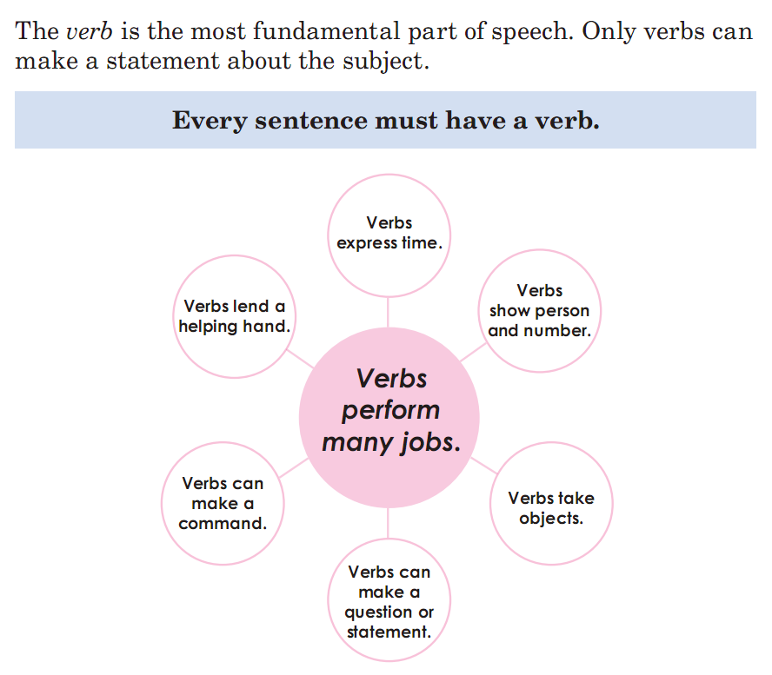
What are verbs?

Slide 7

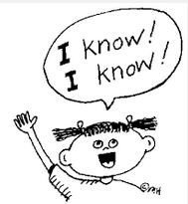


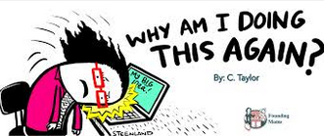

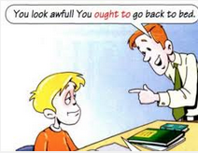

Verb classes
Transitive (V + O) I love you.
Intransitive (V without O) I sleep.
MORE
Lexical love, sleep, run, know, …
(Refer to actions, events and processes)
Dynamic (be + -ing) I am running.
Static (Never -ing) I know.
Linking (Tell the state of being) She is cute.
Verb
Primary Be, have, do
Auxiliary
(Perform grammatical functions or express speaker’s mood)
MORE
Modal Will/would, shall/should, may/might, can/could, must, ought to

Slide 8
Verb forms - Lexical
Infinitive (Dictionary) | 3rd person singular present tense | Other person present tense | Present participle | Past tense | Past participle
V | V-s/es | V | V-ing | V-ed | V-ed
(To) test | Tests | Test | Testing | Tested | Tested
(To) play | Plays | Play | Playing | Played | Played
(To) save | Saves | Save | Saving | Saved | Saved
(To) tie | Ties | Tie | Tying | Tied | Tied
(To) fly | Flies | Fly | Flying | Flied | Flied
(To) watch | Watches | Watch | Watching | Watched | Watched
(To) input | Inputs | Input | Inputting | Inputted | Inputted
(To) build | Builds | Build | Building | Built | Built
(To) run | Runs | Run | Running | Ran | Run
(To) go | Goes | Go | Going | Went | Gone
- Verbs are irregular if they have irregular past tense and past participle forms. - Except for some irregular verbs, past tense and past participle forms are the same.

Slide 9
Verb forms - Auxiliary
Infinitive (Dictionary) | 3rd person singular present tense | Other person present tense | Present participle | Past tense | Past participle
(To) be | Is | Am/Are | Being | Was/Were | Been
(To) have | Has | Have | Having | Had | Had
(To) do | Does | Do | Doing | Did | Done
Will | Will | Will |  | Would
Shall | Shall | Shall |  | Should
Can | Can | Can |  | Could
May | May | May |  | Might
Must | Must | Must |  | Must
Ought to | Ought to | Ought to |  | Ought to
- All primary auxiliaries have irregular forms, except for present participle form. - All modal verbs only have 2 different forms for present and past tenses. They do not have infinitive or participle forms.

Slide 10
Small test
What are wrong in the following sentences?
Yesterday, I hear a funny story. If you hears it, you musted laughs.
You has a beautiful smile. I loves it.
He were giving us flowers when you comed. Did you saw him?
I fly. He flys. She flys. They flyed. No one is flying.
Can you writing fast now? – No, but when I was young, I canned.

Slide 11
Word classes -> Adjectives
Open class
(content / lexical / autosemantic words)
Closed class
(Function / structure words)
Verb
Determiner
Noun
Conjunction
Adverb
Numeral
Adjective
Preposition
Interjection
Pronoun
Have inflection
Building blocks
The glue

Slide 12
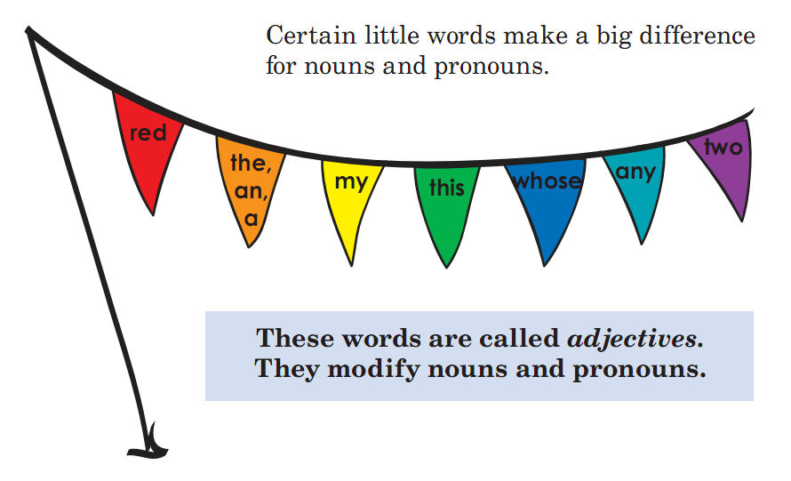
What are adjectives?

Slide 13
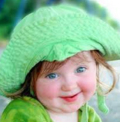
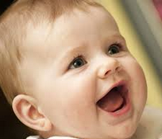
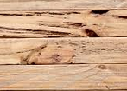





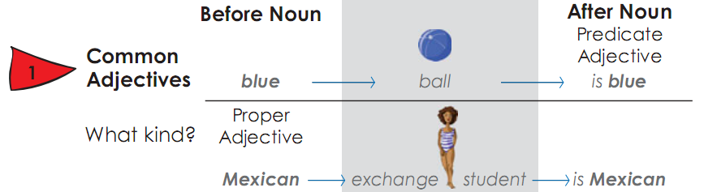
Adjective classes
Careful -> more careful -> the most careful
Cute -> cuter -> the cutest
Which is cuter?
Gradable careful, cute …
Non-gradable wooden, shut …
Adj
See Determiners & Numerals
Limiting (help to identify)
Descriptive (specify size, shape, color, etc.)
Common Green, sunny
Proper Vietnamese, Mexican
Modifying (placed before the noun it describes)
Predicative (come after the linking verb)
Noun

Slide 14
Word classes -> Determiners
Open class
(content / lexical / autosemantic words)
Closed class
(Function / structure words)
Verb
Determiner
Noun
Conjunction
Adverb
Numeral
Preposition
Adjective
Interjection
Pronoun
Have inflection
Building blocks
The glue

Slide 15
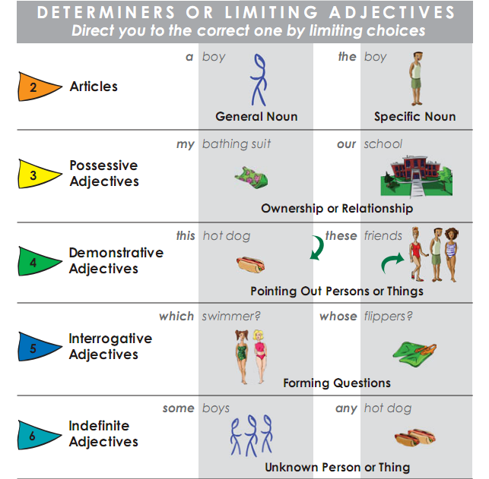
Determiners
Determiners indicate that a noun follows
Identifiers
Quantifiers
(express indefinite quantity)
a lot of
few
little

Slide 16
Word classes -> Numerals
Open class
(content / lexical / autosemantic words)
Closed class
(Function / structure words)
Verb
Determiner
Noun
Conjunction
Adverb
Numeral
Preposition
Adjective
Interjection
Pronoun
Have inflection
Building blocks
The glue

Slide 17
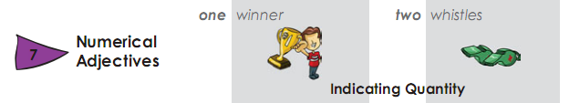
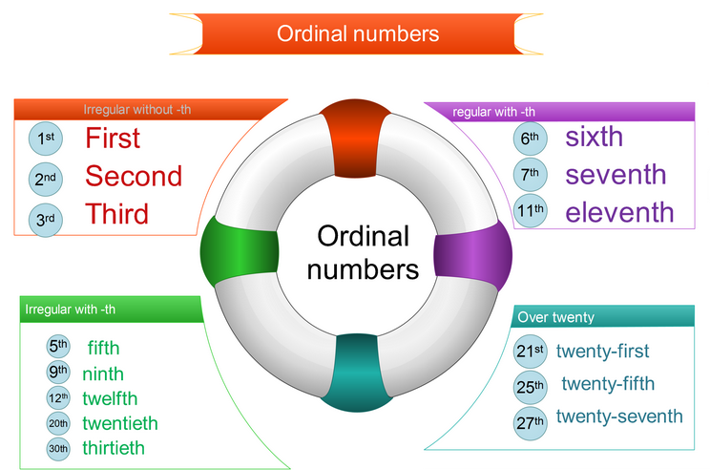
Numerals
Cardinal numbers
Used to:
- Count things: 3 dogs
- Give your age: 10 years old
- Give your phone number
- Give years: 2015
Used to:
- Give a date: My birthday is on the 27th of January.
- Put things in a sequence or order: Liverpool came second in the football league last year.
- Give the floor of a building: on the tenth floor.
- Have birthdays: his twenty-first birthday
http://changingminds.org/techniques/language/speech_parts/cardinals_ordinals.htm
https://www.ego4u.com/en/cram-up/vocabulary/numbers/cardinal
http://www.vocabulary.cl/Basic/Numbers.htm

Slide 18
Small test
What are wrong in these cases?
He is the seven son of Zeus. He has a three eye.
My two offices are in 2 different buildings. The first building has 10 floors. My office 1 is on 10 floor. The two building has 5-th floor. My second office is on floor 5. The first building is older than the other. It was built in 2010-th, and now it is fifth years old.

Slide 19

Any question?

